Slide 1
LAB02
Embedded Programming on PULP II
Alberto Dequino (alberto.dequino@unibo.it)
Călin Diaconu(calin.diaconu2@unibo.it)
Francesco Conti
Giuseppe Tagliavini

Slide 2
Objective of the Class
Low-level SW profiling and Profiling Tools (System Traces and VCD Traces)
Introduction to PMSIS low-level SW libraries
PMSIS BSP: dealing with external RAM devices using uDMA and the peripherals (i.e. HyperBus)
Double Buffering optimization exploiting the uDMA
Final Assignment!
The class is meant to be interactive: coding together and on your own!
Now, open your machine with the PULP-SDK installed (if you need a refresh, similar to Lab 1, slides 5-7)
In a terminal inside WSL, or in the Terminal app on MacOS:
$ git clone https://github.com/EEESlab/HSDES-LAB02-PULP_Embedded_Programming-II.git
$ cd HSDES-LAB02-PULP_Embedded_Programming-II
$ code .
In VS Code, press Ctrl+Shift+P, type in "reopen in container", and select the first option. Open a terminal inside VS Code, and only work in there from this point on.

Slide 3
Profile the gemv
M
N
X
M
=
N
$ cd matrix_vector/
$ make clean all run
pi_perf_conf(1<<PI_PERF_CYCLES | 1<<PI_PERF_INSTR);
pi_perf_reset();
pi_perf_start();
// call the matrix-vector fucntion
gemv(N, M, matrix, vector, output_vec);
pi_perf_stop();
uint32_t instr_cnt = pi_perf_read(PI_PERF_INSTR);
uint32_t cycles_cnt = pi_perf_read(PI_PERF_CYCLES);
printf("Num.Istr: %d Num.Cycles: %d \n", instr_cnt, cycles_cnt);
#MAC = N x M = 50 x 50 = 2500
 | -01 | -03 | -03 HWLoops
Clock Cycles | 48196 | 45562 | 38281
Instr. | 15375 | 12770 | 10473
CPI | 3.13 | 3.57 | 3.66
Clk Cyc / MAC | 19.3 | 18.2 | 15.3
Instr / MAC | 6.1 | 5.1 | 4.1
Why these performance? Is the optimum?

Slide 4
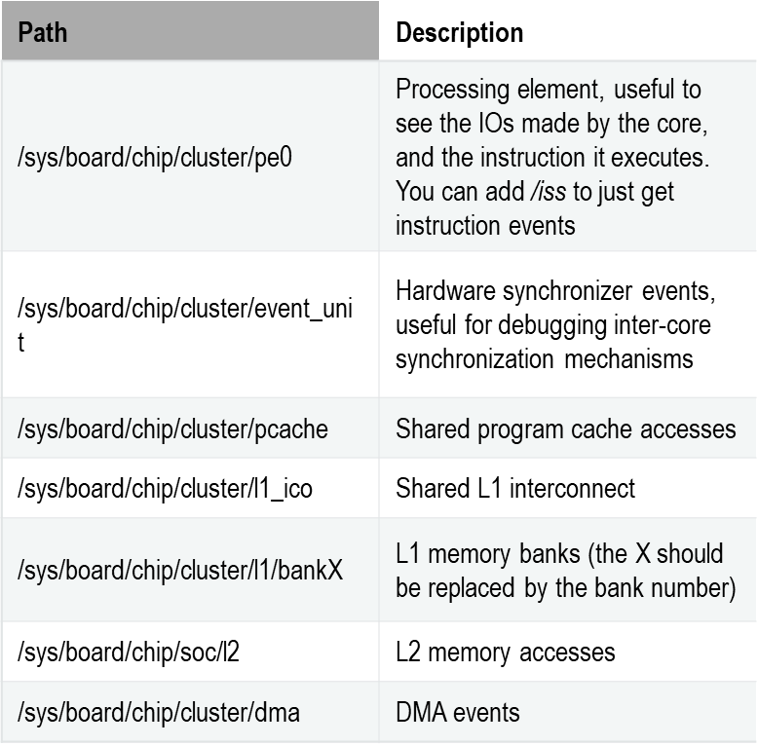
GVSoC Traces
GVSOC is a fully event-based simulator.
Every instance of the platform model (e.g. Cores, DMA) generates events that propagate throughout the platform at a specfic time
The virtual platform allows dumping architectural events and the associated time-tag: the system traces.
/sys/board/chip/<PATH> | Description
.* | All the events
cluster/pe0 | Processing element, useful to see the IOs made by the core, and the instruction it executes. You can add /insn to just get instruction events
soc/fc | Fabric Controller core
cluster/event_unit | Hardware synchronizer events, useful for debugging inter-core synchronization mechanisms
cluster/pcache | Shared program cache accesses
cluster/l1_ico | Shared L1 interconnect
cluster/l1/bankX | L1 memory banks (the X should be replaced by the bank number)
soc/l2 | L2 memory accesses
cluster/dma | DMA events
$ make clean all run runner_args=“--trace=<PATH>:log.txt”
Documentation: https://gvsoc.readthedocs.io/en/latest/system_traces.html

Slide 5
Dumping the Traces of the FC Core (Instruction-only)
Output file in BUILD/PULP/GCC_RISCV/log.txt
$ make clean all run runner_args="--trace=soc/fc/insn:log.txt"
Example of traces output:
2392313046: 45668: /chip/soc/fc/insn gemv:39 M 1c008916 p.lw t1, 4(a6!) t1=00000002 a6=1c0102e8 a6:1c0102e4 PA:1c0102e4
2392431648: 45674: /chip/soc/fc/insn gemv:39 M 1c00891a p.lw a7, 4(a3!) a7=00000004 a3=1c010158 a3:1c010154 PA:1c010154
2392451415: 45675: /chip/soc/fc/insn gemv:39 M 1c00891e c.lw a5, 0(a4) a5=00000008 a4:1c010218 PA:1c010218
2392570017: 45681: /chip/soc/fc/insn gemv:39 M 1c008920 p.mac a5, t1, a7 a5=00000010 a5:00000008 t1:00000002 a7:00000004
2392609551: 45683: /chip/soc/fc/insn gemv:39 M 1c008924 c.sw a5, 0(a4) a5:00000010 a4:1c010218 PA:1c010218
2392629318: 45684: /chip/soc/fc/insn gemv:37 M 1c008926 bne a3, t3, -16 a3:1c010158 t3:1c010218
2392688619: 45687: /chip/soc/fc/insn gemv:39 M 1c008916 p.lw t1, 4(a6!) t1=00000002 a6=1c0102ec
<timestamp> <cycles> <path> <function>:<line> <address> <instruction> <operands> <operands info>
  <timestamp> is the timestamp of the event in picoseconds
  <cycles> ciclo in cui l’istruzione è stata fetchata (?, non decode?)
  <path> is the path in the architecture where the event occurred
  <function>:<line> is the name of the current function and the line of code that is being executed
  <address> is the address of the instruction
  <instruction> is the instruction label
  <operands> is the part of the decoded operands
  <operands info> is giving details about the operands values and how they are used

Slide 6
Try on your own
Determine the set of instructions executed and the per-instruction clock cycles with different compiler optimization level:
-O3 -mnohwloop
-O3
 | -01 | -03 | -03 HWLoops
Clock Cycles | 48196 | 45562 | 38281
Instr. | 15375 | 12770 | 10473
CPI | 3.13 | 3.57 | 3.66
Clk Cyc / MAC | 19.3 | 18.2 | 15.3
Instr / MAC | 6.1 | 5.1 | 4.1
Executed Instructions | p.lw (1) p.lw (1) c.lw (2) p.mac (1) c.sw (1) bne (3) Tot -> 9 | p.lw (1; 6) p.lw (1; 1) p.mac (1; 2) c.sw (1; 6) Bne (3; 3) Tot -> 8 | p.lw (1) p.lw (1) c.lw (2) p.mac (1) c.sw (1) bne (3) Tot -> 9
Load Stall!!
p.lw a5, 4(a4!)
c.add a5, a5, a1
IF
ID
EX
WB
IF
ID
stall
EX
Can we do something better?

Slide 7
System Level Viewpoint: the PULP memory map
The RISC-V core can control/configure peripheral by R/W operations.
PULP MCU Domain
L2 Memory = 512 kB
Cluster subsystem * |  | 0x10000000 - 0x103FFFFF
SoC Peripherals Subsystem |  | 0x1A000000 - 0x1A003FFF
 | SoC FLL | 0x1A100000 - 0x1A1007FF
 | APB GPIO | 0x1A101000 - 0x1A101FFF
 | Micro DMA | 0x1A102000 - 0x1A103FFF
 | SoC Control | 0x1A104000 - 0x1A104FFF
 | FC timer | 0x1A10B000 - 0x1A10BFFF
 | FC Debug | 0x1A110000 - 0x1A110FFF
 | …
MicroDMA Subsystem |  | 0x1A102000 - 0x1A102FFF
 | UART Channel | 0x1A102000 - 0x1A10207F
 | SPI Master Channel 0 | 0x1A102080 - 0x1A1020FF
 | I2C Channel 0 | 0x1A102180 - 0x1A1021FF
 | ….
L2 Memory |  | 0x1C000000 - 0x1FFFFFFF
Interleaved banks
L2
Bank
private banks
L2
Bank
L2
Bank
L2
Bank
L2
Bank
ROM
L2
Bank
DEBUG
Logarithmic Interconnect
GPIO
APB
RISC-V
Core
I2S
Pad Control
SPI M
INTC
DEBUG
CAMIF
µDMA
APB
I2C
UART
CLK
TIMER
EVENT
SoC CTRL
HyperBus
MicroDMA Subsystem

Slide 8
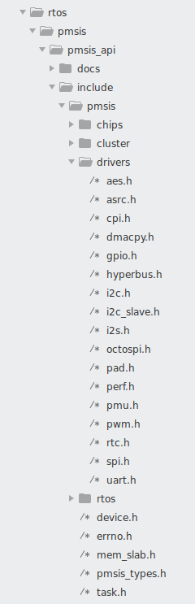
The PMSIS SW stack
PMSIS (PULP Microcontoller Software Interface Standard) is a set of low-level drivers and routines that abstracts the hardware (e.g. memory map) and allows the development of applications portable across a wide range of operating systems (freertos, pulpos, …).
Consists of:
  PMISIS APIs
  Drivers, e.g. peripheral interfaces (spi, gpios, cpi, …)
  RTOS (e.g. malloc, threads, …)
  PMSIS BSP (Board Support Package)
  Drivers for board-specific compoennets (e.g. external RAM)
Conventions:
  pi_ can be called from the fabric controller
  pi_cl can only be called from the cluster side
APIs description and functionalities are also briefly explained in header files, located in the rtos/pmsis/pmsis_api/include/pmsis

Slide 9
PMSIS – PULP Runtime
Application
Device features
(camera ...)
Native RTOS
features
(threading,
native SPI ...)
Chip features
(SPI, DMA,
PMU ...)
PMSIS BSP
hyperram, hyperflash
#include <bsp/bsp.h>
RTOS (freertos, pulpos, zephyr)
PMSIS Drivers
Hyperbus, Uart, DMA, cluster ...
#include “pmsis.h”

Slide 10
pi_devices
Basic structure that contains details about the specific device
Generic functions extract specific information from device description
typedef struct pi_device {
struct pi_device_api *api;
void *config;
void *data;
} pi_device_t;
conf_init()
open_from_conf()
open()
.. do something ..
close()
rtos/pmsis/pmsis_api/include/pmsis/pmsis_types.h
Device specific (cluster/ram/flash)
Initialize the pi_device to be used in the program
Release the resources

Slide 11
Example: External memory HYPERRAM
#include <bsp/bsp.h>
// global defines
struct pi_device ram;
struct pi_hyperram_conf ram_conf;
uint32_t pi_ram_addr;
pulp-sdk/rtos/pmsis/pmsis_bsp/ram/ram.c
RW are blocking functions!
The core idles (sleeps) while waiting for the peripheral event!
pi_hyperram_conf_init(&ram_conf);
pi_open_from_conf(&ram, &ram_conf);
pi_ram_open(&ram);
pi_ram_alloc (&ram, &pi_ram_addr, size );
pi_ram_write (&ram, (uint32_t) pi_ram_addr, (void *) data_L2, size );
pi_ram_read (&ram, (uint32_t) pi_ram_addr, (void *) data_L2, size );
pi_ram_close(&ram);
Remark: uDMA and HyperBus settings are hidden from the users. The drivers take care of it!

Slide 12
Matrix-Vector w/ large matrix!
N=M=50 → int A[M*N] occupies 10kB, hence fits the L2 memory (512kB)
What if N=M=500 ?
M
X
M
=
N
N
A
B
C
$ cd matrix_vector/
$ make clean all run
/pulp/pulp_riscv_gcc/1.0.16/bin/../lib/gcc/riscv32-unknown-elf/7.1.1/../../../../riscv32-unknown-elf/bin/ld: region `L2' overflowed by 545664 bytes
collect2: error: ld returned 1 exit status

Slide 13
gemv using the external memory
Input vector
Temp Variables
Output vector
The input matrix stored in the L3 memory, however, the cores do not have direct access to this memory.
We need to copy each block of data into the L2 memory first using the uDMA.
SoC
L2
Bank
L2
Bank
ROM
=
We copy a single row into the L2 memory and then we apply the gemv function to it
Logarithmic Interconnect
APB Bus
RISC-V
Event
Note: we need an extra buffer in the L2 memory to store the partial result!
HyperRAM
Peripheral Int.
HYPER
CLK
TIMER
DEBUG
µDMA
$ cd matrix_vector_L3/
$ make clean all run
Input matrix
UART

Slide 14
Performance
Let’s take a look at the performance of the gemv using external memory…
 | Data in L2 | Data in L3
Clk Cyc / MAC | 15.3 | 17.17
Instr / MAC | 4.1 | 3.42
CPI | 3.66 | 5.02
CPU
0
1
2
3
…
uDMA
0
1
2
3
…
Try to measure the active cycles : PI_PERF_ACTIVE_CYCLES
Can we improve this?
for(int i=0; i<N;i++){
pi_ram_read(
&ram,
matrix_ptr_L3+(i*M*sizeof(int)),
matrix_row,
(uint32_t) M*sizeof(int));
gemv(1, M, matrix_row, vector, &output_vec[i]);
}

Slide 15
Double Buffering
Make data transfers transparent to the computation with asynchronous reads!
Example of an asynchronous read:
…
pi_task_t task;
pi_ram_read_async( device, pi_ram_addr, data, size, pi_task_block(&task));
pi_task_wait_on(&task);
CPU
0
1
2
3
n-1
n
uDMA
0
1
2
3
…
n-1
n
Instantiate a buffer in L2: PI_L2 int matrix_row[2][M]
Copy the first row to matrix_row[0]
for row= 0…N-1
Use pi_ram_read_async to start copying the i+1-th row to matrix_row[(i+1)%2]
Apply gemv on matrix_row[i%2]
Use pi_task_wait_on to wait the last copy to complete
L3 output
uDMA
L2 buffer_0
Note: you need two buffers in L2!
L2 buffer_1
CPU
Try to apply double-buffering to your matrix_vector example and use perf counters to measure the performance!
Num of clk cyc = 4292348
CPI = 5.017285
Num of clk cyc / MAC = 17.169392
Num of clk cyc = 1366311
CPI = 1.597068
Num of clk cyc / MAC = 5.465244
Crazy
Notes:
Same applies if we also includes other memory level in the story.
So now we have data in L3 and we can

Slide 16
Another vectorial operation
1xN
$ cd vectorial_product/
$ make clean all run
The output matrix cannot be stored in L2!
Try applying asyncronous write operations to the provided example!
Nx1
NxN

Slide 17
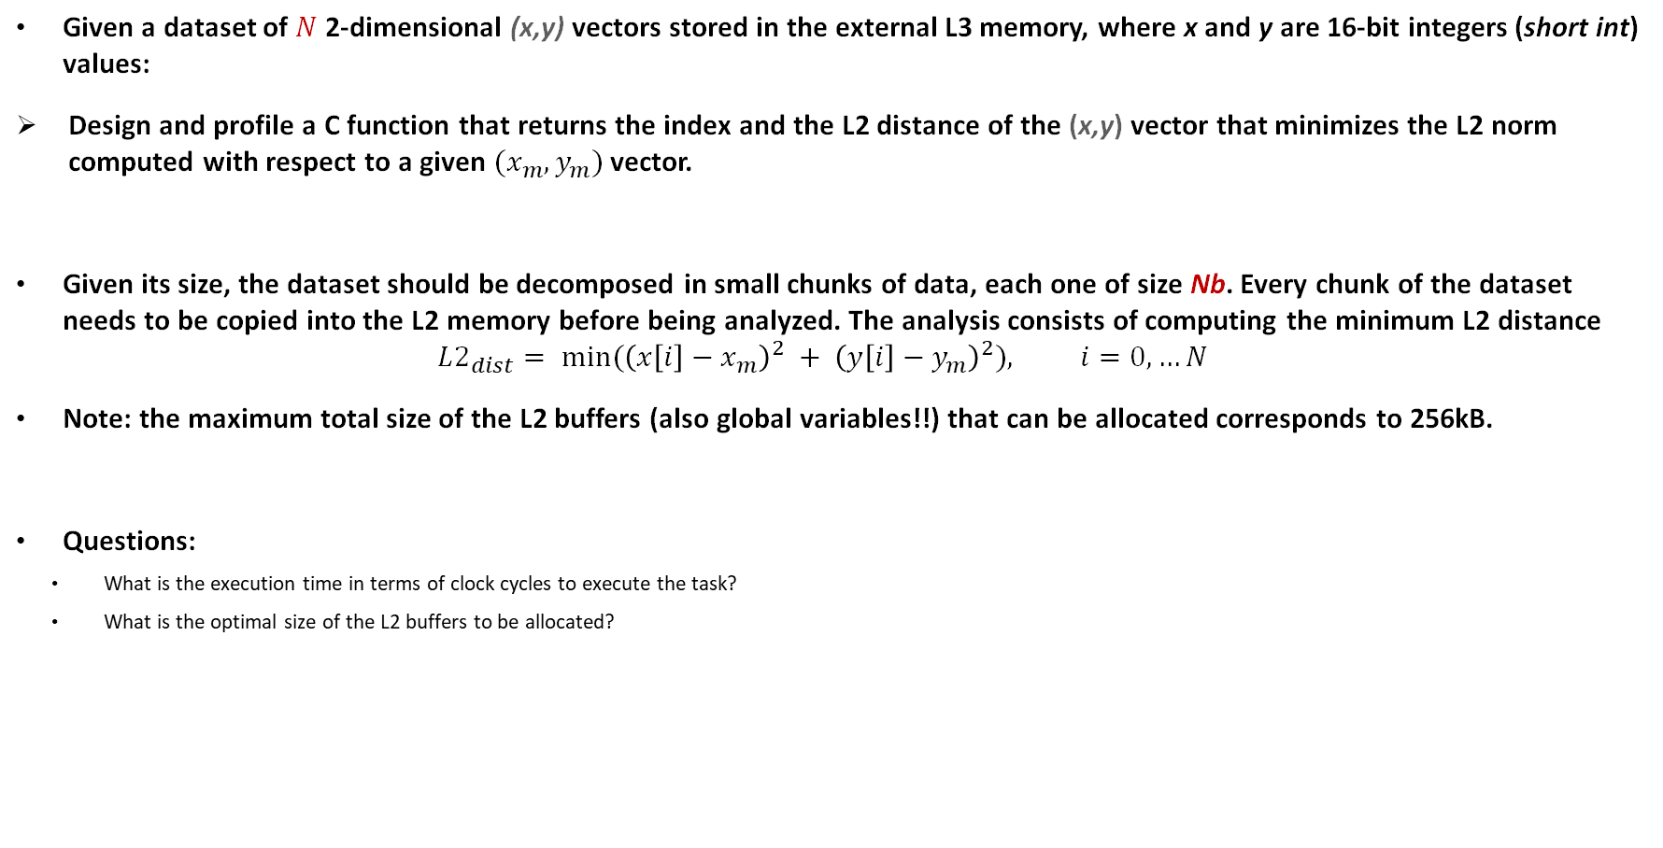
Lab Assignment

Slide 18
Alberto Dequino alberto.dequino@unibo.it

